Slide 1
PRESENTATION on reliable data acquisition system
By
PAN INDIA CONSULTANTS PVT. LTD.

Slide 2
INTRODUCTION:
Pan India Consultants Pvt. Ltd. was established in 1981. It has Head Quarter in Gurgaon and Branch Offices across India.
Pan India offers expertise in sales and services of Marine Science Disciplines, Land and Marine Survey Equipments, Integrated Shipboard Marine System, Hydrographic and Oceanographic Software and Systems, Engineering and Electronic Systems, Environmental Instruments.
We have association with leading overseas manufacturers and corporates based across globe.
We are associated with Indian Navy, Major Ports, Research Organisations like NIO, NIOT, NCAOR, INCOIS, CIFE, CMFRI, CWPRS, Land Records, SOI etc. since long time and providing our solutions to them with after sales AMC also.
Pan India has over all around 350+ highly qualified staffs in different fields to cater support to our clients.

Slide 3
Reliable data acquisition
Reliable Data Acquisition is back bone for any type of study or research projects in field of Hydrography, Hydrology etc.
We require Reliable data of Past and Present to study the behaviour of the Rivers/Dams and can interpret future based on those data so data acquisition is a very important factor for any type of research project.
For Reliable Data Acquisition, we need Data Acquisition Systems from best Manufacturers across world so that we can rely on the data collected in real time.
So, we are here from Pan India Consultants Pvt. Ltd. to introduce multiple equipments required for study of Rivers/Dams and their changing behaviours.

Slide 4
SURVEY EQUIPMENTS:
DGPS: Basic Beacon DGPS to High end PPK & RTK DGPS Solutions.
Echo Sounder: Single Beam (Single Frequency & Dual Frequency), Multi Beam Echo Sounder.
Sub Bottom Profilers for study of sediments and sub layers of bottom.
Side Scan Sonar, Motion Sensors, Oceanographic Sensors like CTD Sensor, Current Meters, Current Profilers, Tide Gauge, Multiparameter water quality meter, Different Parameter Sensors.
Remotely Operated Vehicles, Turbulence Profilers, Gliders etc.
Data Acquisition and Processing Software.
We also provide integrated system for Hydrographic Surveys including all equipments, Boat etc.

Slide 5
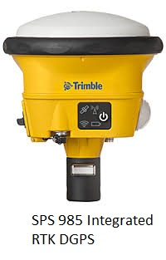
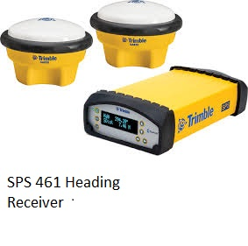
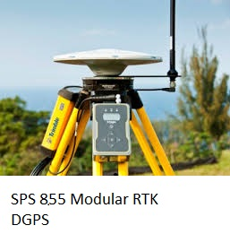
DGPS from trimble

Slide 6
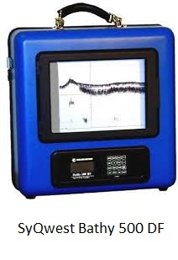
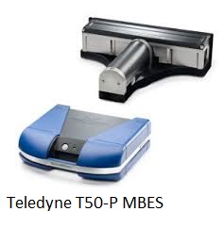
Echo SOUNDERS:

Slide 7
Bathy 500 echo sounder
Very Portable and Reliable survey grade Echo Sounder.
Measures depth from 0.3m to 640m.
Available in Single Frequency and Dual Frequency Modes.
With Paper Chart & Digital Display.

Slide 8
Teledyne t50-p Multi beam echo sounder

Slide 9
Sub Bottom Profiler:
Sub-bottom profiling systems identify and measure various marine sediment layers that exist below the sediment/water interface.
A sound source emits an acoustic signal vertically downwards into the water and a receiver monitors the return signal that has been reflected off the seafloor.
Some of the acoustic signal will penetrate the seabed and be reflected when it encounters a boundary between two layers that have different acoustic impedance.
The system uses this reflected energy to provide information on sediment layers beneath the sediment-water interface.

Slide 10
Acoustic impedance is related to the density of the material and the rate at which sound travels through the material.
When there is a change in acoustic impedance, such as the water-sediment interface, part of the transmitted sound is reflected.
However, some of the sound energy penetrates through the boundary and into the sediments. This energy is reflected when it encounters boundaries between deeper sediment layers having different acoustic impedance.

Slide 11
SyQwest StrataBox:

Slide 12
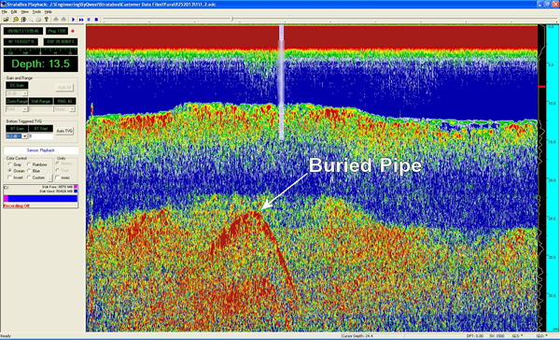

Slide 15
Data acquisition and processing Software: EIVA
Software is used to collected data from multiple sensor like Echo Sounder, Sub Bottom Profiler, DGPS etc. connected at the time and to synchronize the data.
The Data collected needs to be cleaned and Processed to get final output like DTM, 3D Model, Navigation Charts etc.
The Software is also used to clean the acquired data so that our final output contains only Valid data and there is no Garbage data

Slide 16
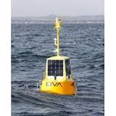
EIVA TOUGHBOY PANCHAX
Wave Buoy with lowest possible Rate for continuous monitoring
of Water Parameters for longer duration in real time.
Comes with Internal Battery with Back up of 2 Years as well as
External Solar Power Source.
We can Integrate any Oceanographic sensors like ADCP, Salinity
Sensor, Water Quality Meter .

Slide 17
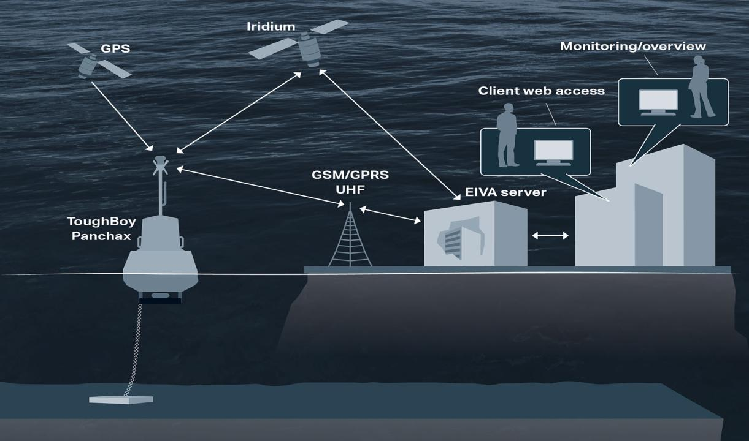

Slide 18
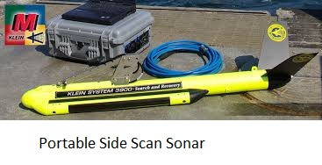
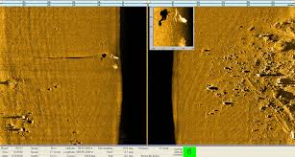
Side Scan Sonar

Slide 19
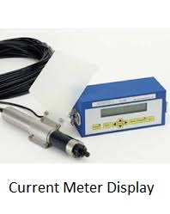
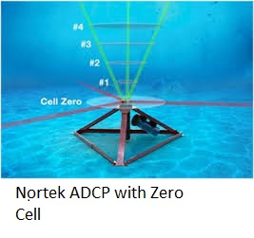
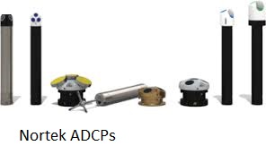
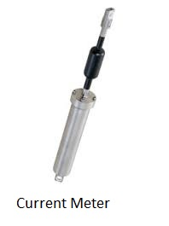
Oceanographic sensors: Current meters and profilers

Slide 20
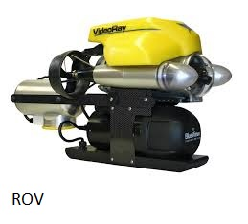
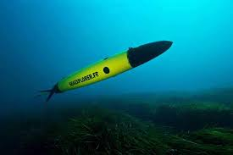
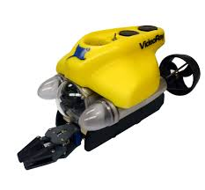
ROV & GLIDERS

Slide 21
VISTA CLARA GMR for Ground Water
GMR MEASUREMENTS PROVIDE
Non-invasive direct detection of groundwater
Spatial resolution of hydrogeologic parameters in 1D, 2D, or even 3D
Quantitative determination of water content and porosity
Estimation of mobile versus bound water content
Estimation of relative or calibrated hydraulic conductivity and transmissivity
Investigation to depths up to 150 meters

Slide 23
GMR APPLICATIONS IN HYDROLOGY INCLUDE
Groundwater exploration and well site selection
Determination of water storage and specific yield
“Virtual pump testing”: estimation of aquifer properties
Imaging of preferential flow zones (e.g. fractures, karst conduits, paleochannels)
Parameterization of groundwater models at local to basin scales
Integration of logging and surface-based NMR measurements

Slide 24
We have Partnership with Pramitee Engineering & Surveys Pvt. Ltd. to provide all type of survey services like Land Survey, Bathymetric Surveys etc. They use high end survey equipments to provide accurate and reliable data.

Slide 25
THANK YOU!!!!!!

